Slide 1
Cluster Analysis of South Asian Restaurant Locations in the City of Brampton
Taranveer Birk
July 14, 2019

Slide 2
Introduction
The Greater Toronto Area serves as a home for many immigrants from all parts of the world. There are many celebrated enclaves of ethnic decent that exist throughout the surrounding cities of Toronto.
A very pronounced enclave of ethnic people is the South Asian (Afghanistan, Bangladesh, Bhutan, Indian, Maldives, Nepal, Pakistan, Sri Lanka) Community within the city of Brampton.
The 2015 Canadian census reported that roughly 44% of residences were of South Asian descent, one of the few Canadian cities to have an ethnic community with the largest general population among all other communities.
With such a pronounced presence within a city, this report will target stakeholders that are interested in opening a South Asian Restaurant in the city of Brampton (1).

Slide 3
Data
As stated in the introduction, we require a few external data sources to help with our analysis, they include:
StatsCan - 2015 Census data, to provide background on the ethnic population distribution of the federal census tracts in Brampton.
The geocoordinates for the approximate addresses of a central location within the city of Brampton will be obtained using Google Maps API reverse geocoding.
Venue data for locational analysis will be obtained using the Foursquare API. The venue data will assist in mapping locations and calculating distance from the city centre.
Addresses of centroid locations created during analysis will also be obtained using the Google Maps API for reverse geocoding. Addresses will be used to present optimal locations in the results section of the report.
In addition to collecting the data in our notebook, it will be merged and processed to complete a clustering analysis based on the requirements of an ideal space within the city.

Slide 4
Methodology
The objective will be to use the retrieved data to create and map clusters that have a low density of Indian restaurants within a particular radius. Based on our city center location, we will work with roughly a 7km radius around the desired point. This should be sufficient surface coverage for a densely suburban population. With the combination of centroid location data and the FourSquare venue data, we can use Folium Maps to explore densities of restaurant throughout the city.
Heat mapping and markers will be used to narrow down specific neighborhoods of interest. Ideally, we want to reduce our radius from 10km to in-between 2-3km, and would preferably be close to our city center. We will refer to this area as the ROI Center, and apply the necessary parameters to view on the map. After we’ve defined our area of analysis, we can add new centroid clusters at a lower granularity. These centroids can be restricted by distance from other restaurants or Indian restaurants, this will allow us to prepare for k-means clustering in our final stage of analysis.

Slide 5
Analysis
Once we’ve loaded our locations Dataframe, we should have sufficient data to:
1. Create a heatmap of restaurants and South Asian locations throughout the city.
2. Create a heatmap which focuses on a promising radius close to our city center.
3. Generate candidate locations within ROI area with applied restrictions.
4. Use K-Means clustering to cluster our ROI candidate locations, narrow down top candidates.
5. Present top locations as markers on the final map.
Much of the interpretation of good/bad areas to explore will come from visually analyzing our maps. Inputs will be adjusted to assume optimal values for each of our targeted assessments.

Slide 6
Analysis Cont.
Figure 5. Folium Heatmap of restaurant locations surrounding our 'City Center' (3)

Slide 7
Analysis Cont.
Figure 6. Our ‘City Center’ and ‘RIO Center’ mapped with markers alongside heat density of restaurants. (3)

Slide 8
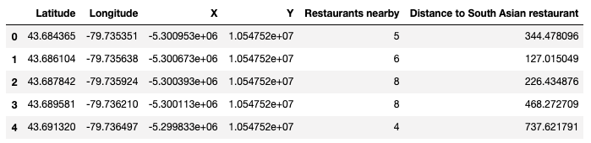
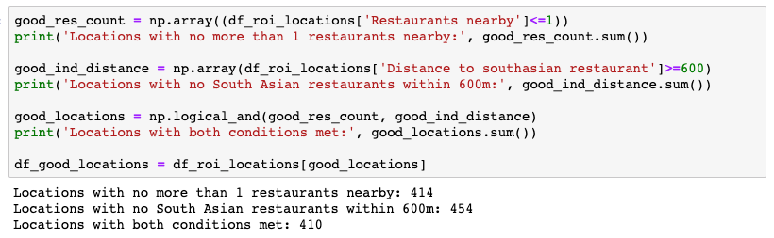
Analysis Cont.
Figure 7. Dataframe of ROI centroids with location and distance metrics. (3)
Figure 8. Stakeholder location restrictions to apply to our cluster analysis.

Slide 9
Analysis Cont.
Figure 10. Final 35 clusters of ‘good locations’ which match our stakeholder requirements.

Slide 10
Results and Discussion
Once we were able to cluster zones closer to the street level using the k-means algorithm, we explored plausible locations that within our ‘ROI zone’ that would meet our stakeholder requirements. Recommended locations were analyzed and verified visually as commercially zoned lots. Although these locations meet our competitive distance requirements, there may be more research required to assess other optimization factors not explored in this analysis. In total there were 6 locations selected from our analysis:
Figure 12. Our top 6 ROI locations selected after analysis.

Slide 11
Conclusion
Our stakeholders requested an analysis of the city of Brampton’s restaurant landscape, in order to find ideal commercial location for a south Asian restaurant based on specific requirements.
By establishing the correct steps to collect, process and analyze FourSquare locational data in a python environment, we were able to conclusively explore the restaurant distribution across the city.
Once our clustering of ‘ROI centroids’ was complete, it was much easier to explore at street level within a 2.2 km radius.
The Folium map layer distinguishes between deferent land use types (residential, industrial, commercial ect.) and with the cluster mapping; top ROI locations we’re quickly narrowed down for this analysis.

Slide 12
Data Sources
1. StatsCan https://www12.statcan.gc.ca/census-recensement/2016/dp-pd/index-eng.cfm
2. Google Geocoding API
3. FourSquare Developer API

